Slide 1
THEORY OF PRODUCTION
AND COST

Slide 2
The Technology of Production
The Production Process
  Combining inputs or factors of production to achieve an output
Categories of Inputs (factors of production)
  Labor - Materials
  Land - Energy
  Capital - Machinery
  Mineral resources - Equipment
Notes:
4

Slide 3
The Technology of Production
Production Function:
  Indicates the highest output that a firm can produce for every specified combination of inputs given the state of technology.
Notes:
5

Slide 4
The Technology of Production
The production function for inputs:
Q = F(X₁, X₂, X₃, ……, X_{n})
where Q = Output, Xs = various inputs used.
Q = F (L, K); Q=AL^{α}K^{β}
For a given technology
Notes:
6

Slide 5
The Organization of Production
Inputs
  Labor, Capital, Land, Raw materials
Fixed Inputs
- Inputs that do not vary with the level of output
- Egs : plant, machinery, bank loan, permanent
staff.
Variable Inputs
- Inputs that vary with the level of output
- Egs : hourly labour, raw materials.

Slide 6

Short Run Vs Long Run
Short Run
That period in which a firm can make only partial adjustment of inputs
- Eg : the firm may be able to vary the amount of labour, but cannot change capital.
Long Run
That period in which a firm can adjust all inputs according to changed conditions. i.e. all inputs are variable.

Slide 7
Short Run Production Function -
One Variable Input (Labor)
Total Product : TP_{L} = Q = F(L)
- total output of all workers
Average Product : AP_{L}= TP_{L}/ L
- output per worker
Marginal product : MP_{L} = ΔTP / ΔL
- output of the additional worker
Notes:
18

Slide 8
SR Production with
One Variable Input (Labor)
Slope of tangent at a
point shows ΔTP/ΔL = MP_{L}
Output
per
Month
D
Slope of ray from origin
shows TP_{L}/L = AP_{L}
112
C
Total Product
60
A: slope of tangent = MP (20)
B: slope of OB = AP (20)
C: slope of OC= MP & AP
B
A
0
1
2
3
4
5
6
7
8
9
10
Labor per Month
Notes:
23

Slide 9
The Law Of Diminishing Marginal Returns (SR)
Holding all factors constant except one, the law of DMR says that :
“Beyond some value of the variable input, further increases in the variable input lead to steadily decreasing marginal product of that input”.
Trying to increase labour input without also increasing capital will bring diminishing marginal returns.

Slide 10
Wheat production per year from a particular farm
(SR – capital fixed)
No.of Workers(L) | TP_{L} (tonnes) | AP_{L} = TP_{L}/L | MP_{L} = ΔTP/ΔL
0 | 0 | - | -
1 | 3 | 3 | 3
2 | 10 | 5 | 7
3 | 24 | 8 | 14
4 | 36 | 9 | 12
5 | 40 | 8 | 4
6 | 42 | 7 | 2
7 | 42 | 6 | 0
8 | 40 | 5 | -2

Slide 11
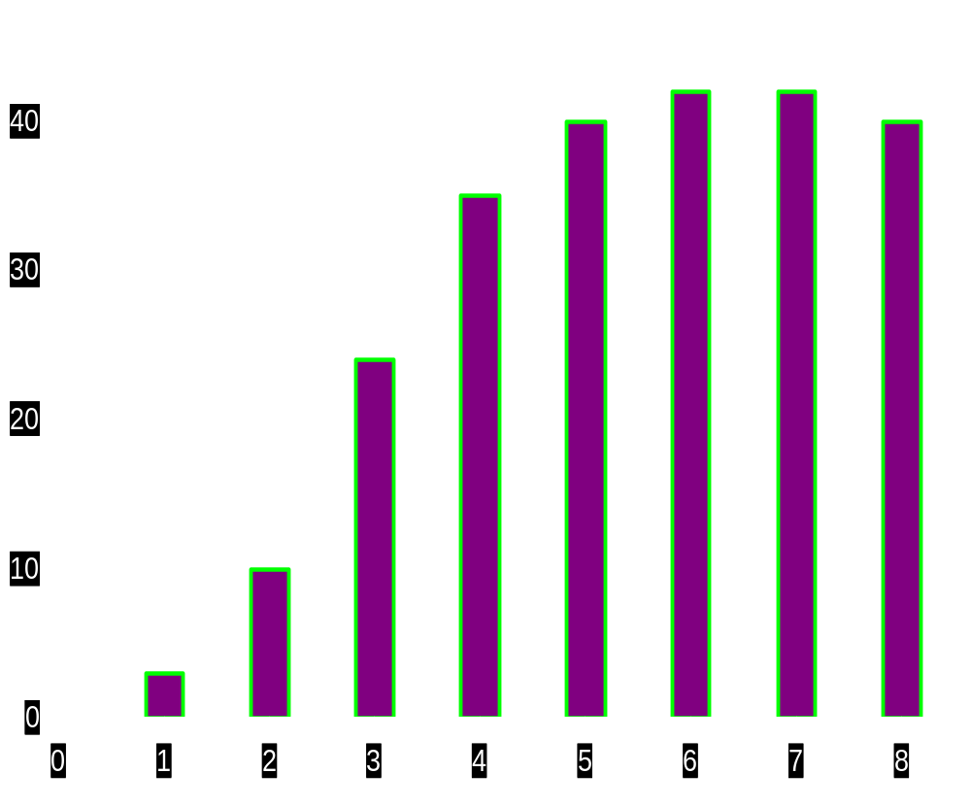

Wheat production per year from a particular farm
Number of
workers
0
1
2
3
4
5
6
7
8
TP_{L}
0
3
10
24
36
40
42
42
40
Tonnes of wheat produced per year
fig
Number of farm workers

Slide 12
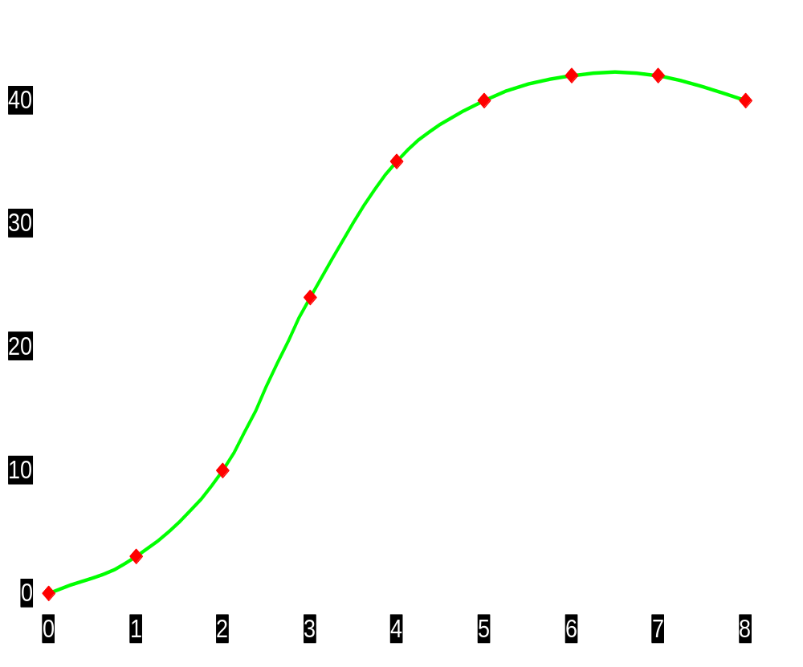
Wheat production per year from a particular farm
TP_{L}
Tonnes of wheat produced per year
fig
Number of farm workers

Slide 13
Wheat production per year from a particular farm
TP_{L}
Diminishing returns
set in here
b
Tonnes of wheat produced per year
a
fig
Number of farm workers

Slide 14
Wheat production per year from a particular farm
d
TP_{L}
Maximum output
b
Tonnes of wheat produced per year
a
fig
Number of farm workers

Slide 15
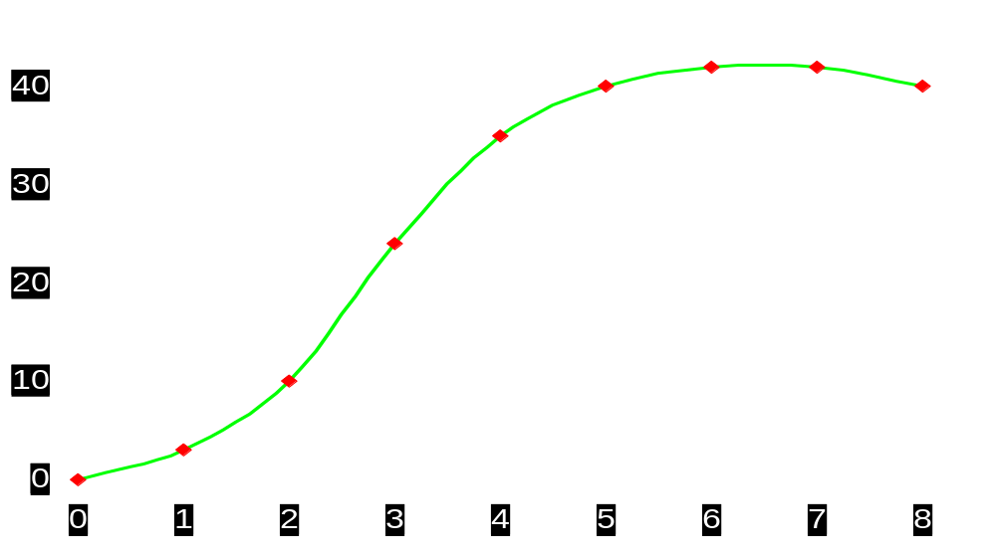

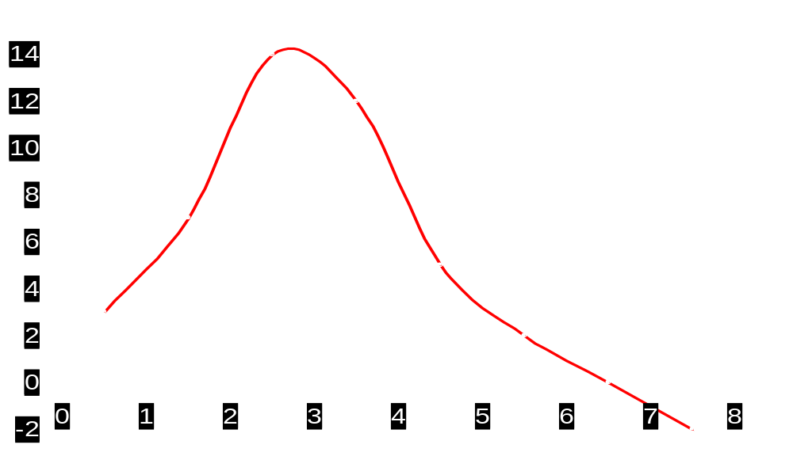
Wheat production per year from a particular farm
TP_{L}
b
Tonnes of wheat per year
Number of
farm workers (L)
Tonnes of wheat per year
Number of
farm workers (L)
fig
MP_{L}

Slide 16
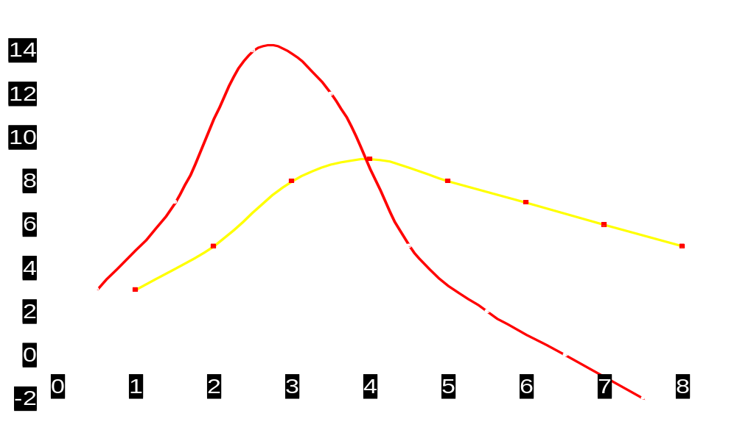
Wheat production per year from a particular farm
TP_{L}
Tonnes of wheat per year
Number of
farm workers (L)
AP_{L} = TP_{L} / L
Tonnes of wheat per year
AP_{L}
Number of
farm workers (L)
fig
MP_{L}

Slide 17
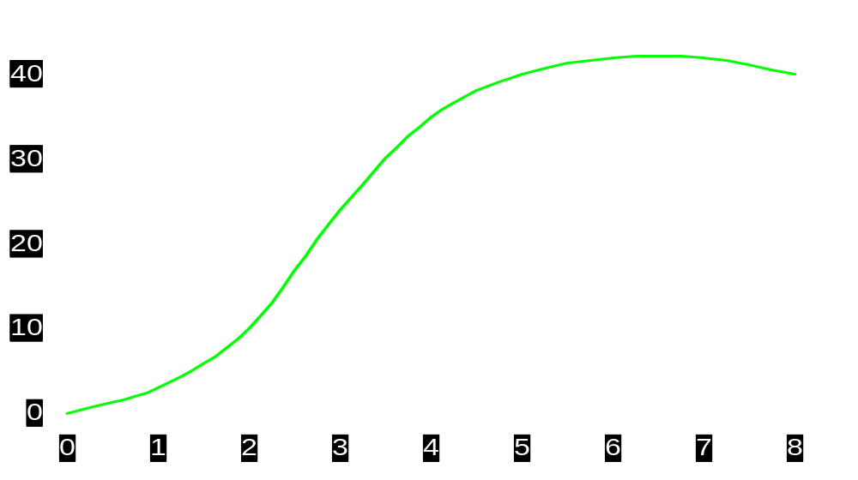
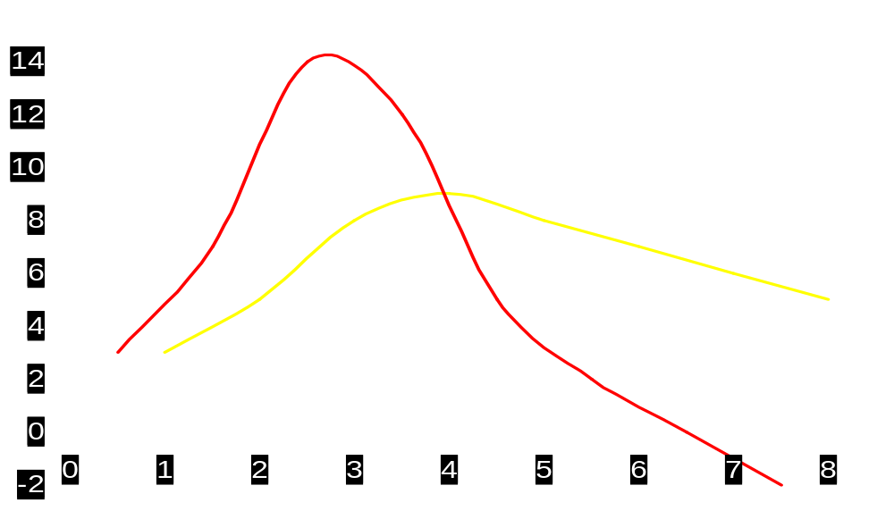
Wheat production per year from a particular farm
TP_{L}
Tonnes of wheat per year
b
Diminishing returns
set in here
Number of
farm workers (L)
b
Tonnes of wheat per year
AP_{L}
Number of
farm workers (L)
fig
MP_{L}

Slide 18
Wheat production per year from a particular farm
d
TP_{L}
b
Maximum
output
Tonnes of wheat per year
Number of
farm workers (L)
b
Tonnes of wheat per year
AP_{L}
d
Number of
farm workers (L)
fig
MP_{L}

Slide 19
Wheat production per year from a particular farm
Slope = TP_{L} / L
= AP_{L} = MP_{L}
c
d
TP_{L}
Tonnes of wheat per year
b
Number of
farm workers (L)
b
c
Tonnes of wheat per year
AP_{L}
d
Number of
farm workers (L)
fig
MP_{L}

Slide 20
SR Production with
One Variable Input (Labor)
Observations:
  When MP_{L} = 0, TP_{L} is at its maximum
  When MP_{L} > AP_{L} , AP_{L} is increasing
  When MP_{L} < AP_{L} , AP_{L} is decreasing
  When MP_{L} = AP_{L} , AP_{L} is at its maximum.
Notes:
28

Slide 21
SR Production with
One Variable Input (Labor)
Outputper
Month
Observations:
Left of E: MP > AP & AP is increasing
Right of E: MP < AP & AP is decreasing
E: MP = AP & AP is at its maximum
30
Marginal Product
E
20
Average Product
10
0
1
2
3
4
5
6
7
8
9
10
Labor per Month
Notes:
27

Slide 22
SR Production with
One Variable Input (Labor)
  AP = slope of line from origin to a point on TP, lines B, & C.
  MP = slope of a tangent to any point on the TP line, lines A & C.
Output
per
Month
Output
per
Month
D
112
C
30
E
60
20
B
A
10
0
1
2
3
4
5
6
7
8
9
10
Labor
per Month
0
1
2
3
4
5
6
7
8
9
10
Labor
per Month
Notes:
23

Slide 23
Optimal Use of the Variable Input (SR)
Marginal Revenue Product Of Labour (MRP_{L}) – It is the extra (additional) revenue (benefit) that the firm receives from production by an extra (additional) worker.
MRP_{L} = ΔTR/ΔL
We know that TR = f(Q) and Q = f(L)
i.e. MRP_{L} = ΔTR/ΔL = ΔTR/ΔQ * ΔQ/ΔL
or MRP_{L} = (MP_{L})(MR)
If MR = P, then, MRP_{L}= MP_{L}* P

Slide 24
Optimal Use of the Variable Input (SR)
ΔTC
ΔL
Marginal Resource Cost of Labor
MRC_{L} =
As long as the incremental market value of the extra output
produced (that is, the marginal revenue brought in) is
greater than the cost of hiring the extra labour (the cost of
wages), then the firm should go ahead and employ the extra
labour.
Profits are maximised where the marginal revenue brought
in is exactly equal to the cost of labour to be employed, i.e. -
Optimal Use of Labor :
MRP_{L} = MRC_{L}

Slide 25
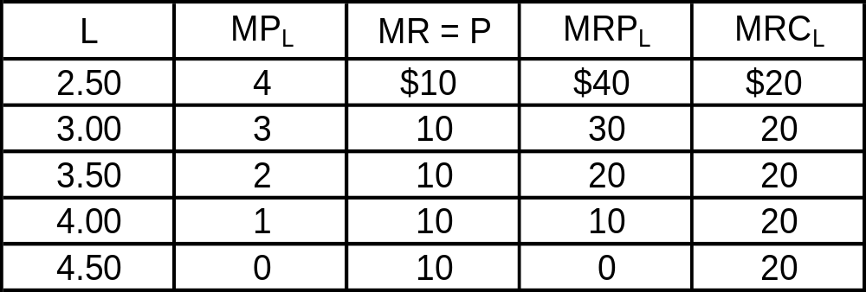
Optimal Use of the Variable Input (SR)
Use of Labor is Optimal When L = 3.50

Slide 26
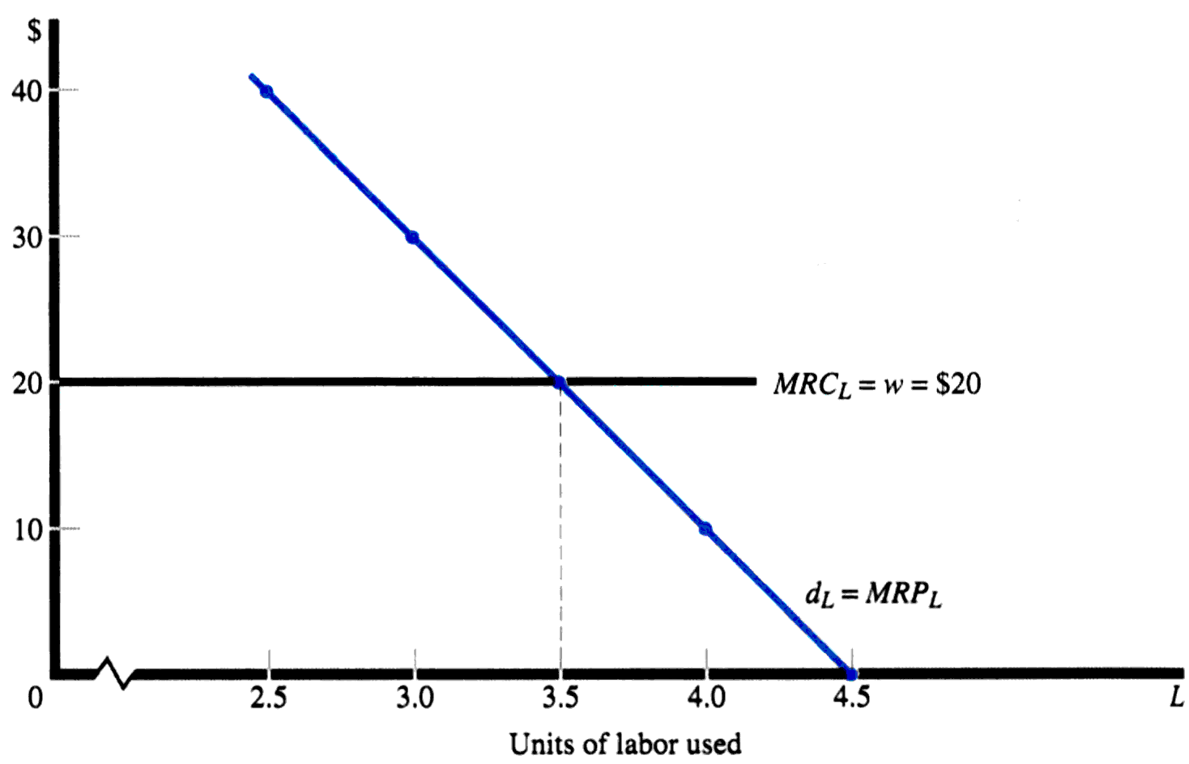
Optimal Use of the Variable Input (SR)
To the left of E, extra employment
adds more to revenue than to labour
costs. To the right of E, the reverse
is true.
Optimal use of L at pt E: MRP_{L} = MRC_{L}
E

Slide 27
LR Theory Of Production
All factors are variable in the LR
Isoquants show combinations of two inputs that can produce the same level of output.
Isocost lines represent all combinations of two inputs that a firm can purchase with the same total cost. It represents the budget line of the firm.

Slide 28
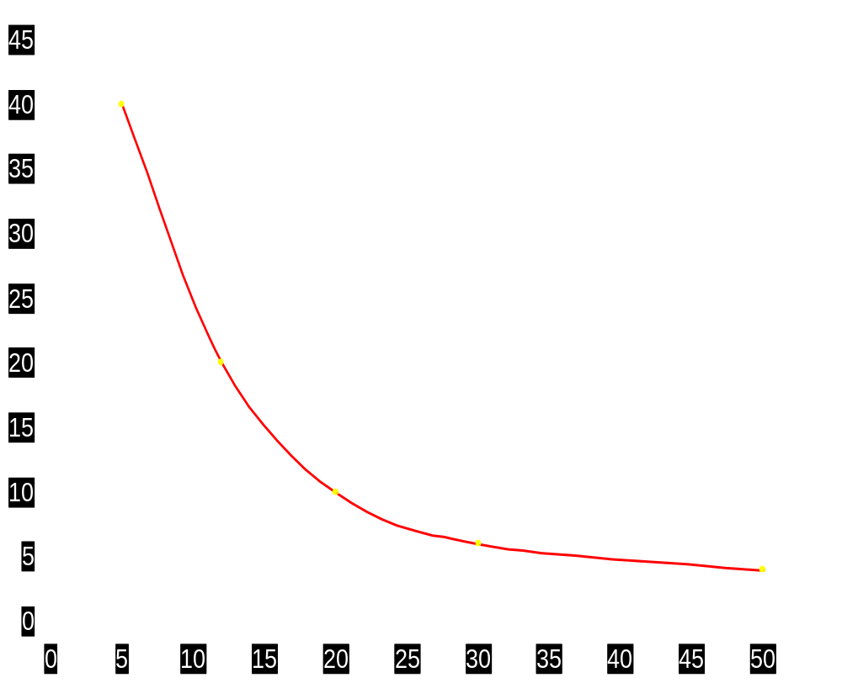
An isoquant
a
Units
Of Q
100
100
100
100
100
Units
of K
40
20
10
6
4
Units
of L
5
12
20
30
50
Point on
diagram
a
b
c
d
e
Units of capital (K)
b
c
d
Q=100
e
fig
Units of labour (L)

Slide 29
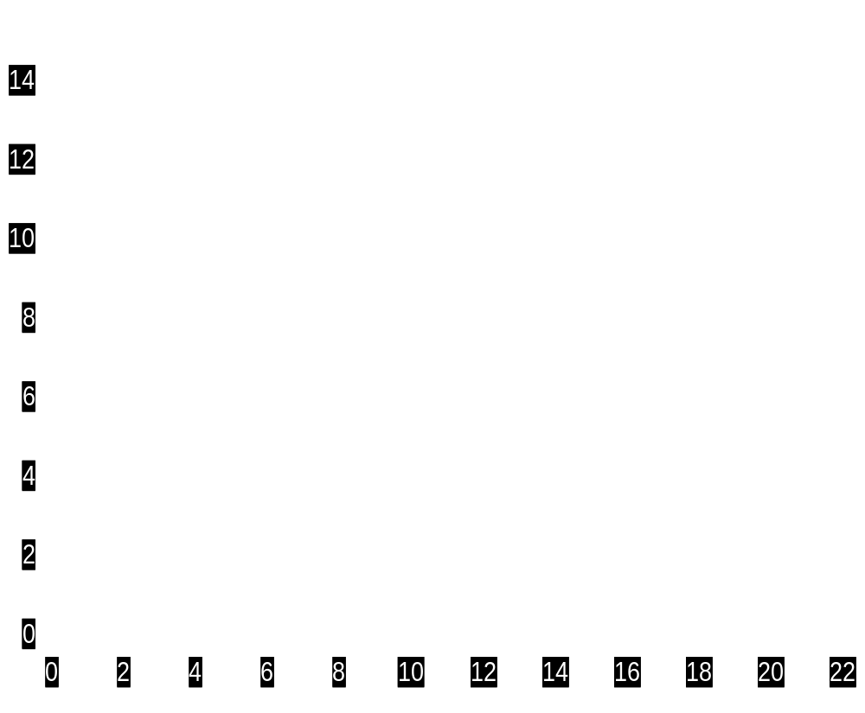
Diminishing marginal rate of technical (or factor) substitution
g
MRTS_{LK} = 2
MRTS_{LK} = ΔK / ΔL
ΔK=2
h
Units of capital (K)
ΔL=1
isoquant
fig
Units of labour (L)

Slide 30
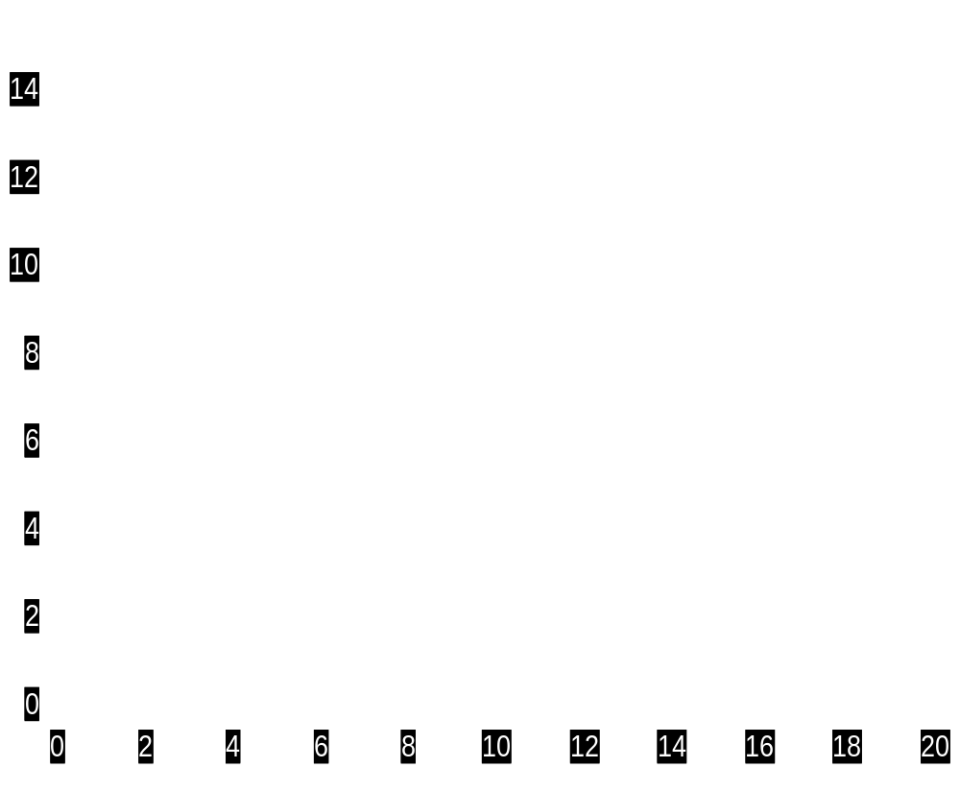
Diminishing marginal rate of technical (or factor) substitution
g
MRTS = 2
MRTS_{LK} = ΔK / ΔL
ΔK = 2
h
ΔL = 1
Units of capital (K)
j
MRTS = 1
ΔK = 1
k
ΔL = 1
isoquant
fig
Units of labour (L)

Slide 31
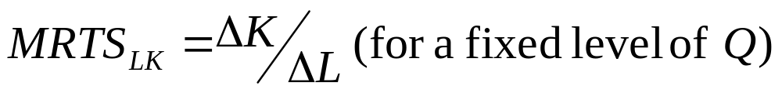
LR Production with Two Variable Inputs
Substituting Among Inputs
  The marginal rate of technical substitution equals:
Notes:
59

Slide 32
LR Production With Two Variable Inputs
Marginal Rate of Technical Substitution
MRTS = ΔK/ΔL = MP_{L}/MP_{K}
Diminishing MRTS occurs because of diminishing returns and implies isoquants are convex.
L and K are imperfect substitutes.

Slide 33
IMPERFECT SUBSTITUTES
ISOQUANTS – MRTS
Decrease in one factor
Requires more and more
of the other one for substitution
Capital
Or increase in L input
requires giving up less
and less of the K input
in order to keep Q constant.
C
1
C
Q
2
3
C
Q
3
2
Q
1
L
L
L
1
2
3
Labor

Slide 34
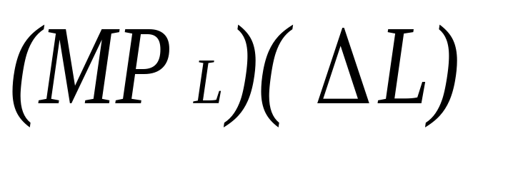
LR Production with
Two Variable Inputs
Observations:
MRTS and Marginal Productivity
    The change in output (along an IQ) from a change in labor equals:
Notes:
62

Slide 35
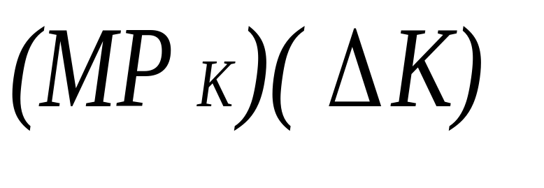
LR Production with
Two Variable Inputs
Observations:
MRTS and Marginal Productivity
    The change in output (along an IQ) from a change in capital equals:
Notes:
62

Slide 36
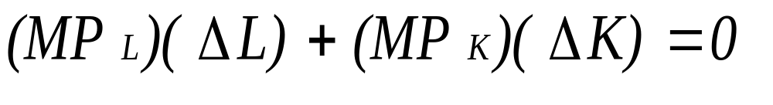

LR Production with
Two Variable Inputs
Observations:
MRTS and Marginal Productivity
    If output is constant (along an IQ) and labor is increased, then:
Notes:
63

Slide 37
Optimal Combination of Inputs
Isocost lines represent all combinations of two inputs that a firm can purchase with the same total cost. It is the budget line of the firm.
TC = P_{L}.L + P_{K}.K Budget line
K = TC/P_{K} - (P_{L}/P_{K})L slope of BL is P_{L}/P_{K}
where TC = Total Cost
P_{L} = wage rate of labour
P_{K} = cost of capital

Slide 38
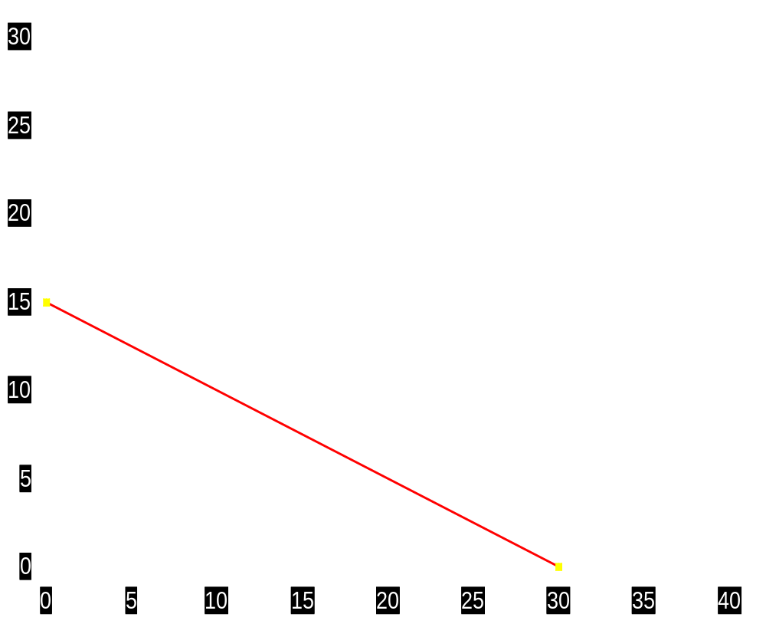
An Isocost Line
Assumptions
P_{K} = Rs.20 000
P_{L} = Rs.10 000
TC = Rs.300 000
a
Units of capital (K)
TC = Rs.300 000
fig
Units of labour (L)

Slide 39

An Isocost Line
Assumptions
P_{K} = Rs.20 000
P_{L} = Rs.10 000
TC = Rs.300 000
a
Units of capital (K)
b
TC = Rs.300 000
fig
Units of labour (L)

Slide 40

An Isocost Line
Assumptions
P_{K} = Rs.20 000
P_{L} = Rs.10 000
TC = Rs.300 000
a
Units of capital (K)
b
c
TC = Rs.300 000
d
fig
Units of labour (L)

Slide 41
ISOQUANT – ISOCOST ANALYSIS
Least cost combination of factors for a given output
  Point of tangency
  Comparison with marginal productivity approach
  Highest output for a given cost of
  production.
  Eqn condition : MP_{L}/MP_{K} = P_{L}/P_{K}

Slide 42
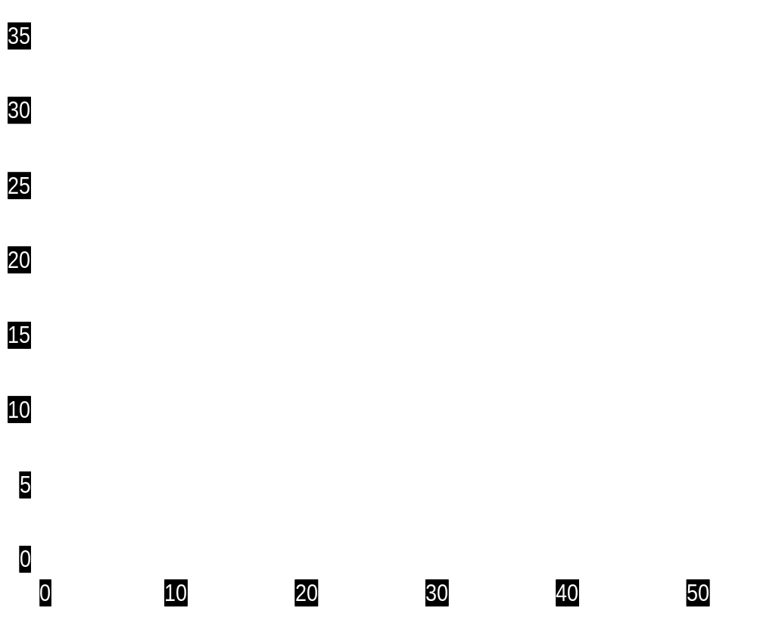
Finding the least-cost method of production
Optimal combination corresponds
to the point of tangency of isoquant and isocost. i.e. where -
Slope of BL = slope of isoquant i.e
P_{L}/P_{K} = MRTS_{LK} = MP_{L}/MP_{K}
s
TC = Rs500 000
Units of capital (K)
TC = Rs400 000
r
t
Q₁
fig
Units of labour (L)

Slide 43
LR Production : Returns to Scale
Returns to scale refers to the proportionate change in output resulting from a certain change in all inputs. It is a LR concept.
Production Function Q = f(L, K)
λQ = f(hL, hK)
If λ = h, then f has constant returns to scale.
If λ > h, then f has increasing returns to scale.
If λ < h, the f has decreasing returns to scale.

Slide 44
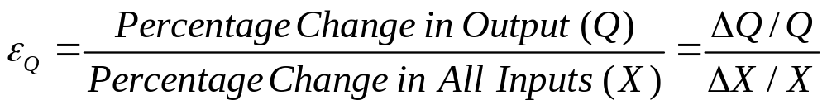
LR Production : Returns to scale
Returns to scale can also be measured using the output elasticity.
Output elasticity
ε_{Q} = 1 (CRS); ε_{Q} > 1 (IRS); ε_{Q} < 1 (DRS)

Slide 45
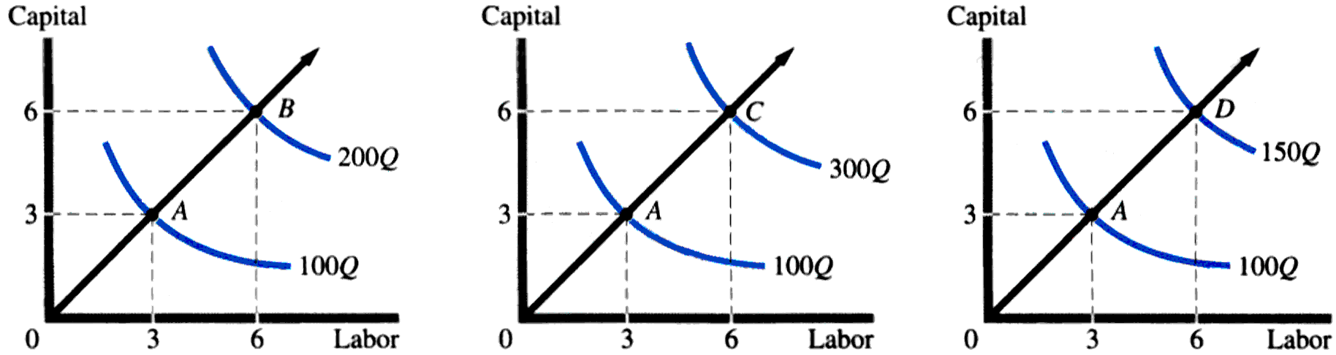
Returns to Scale
Constant Returns to Scale
Increasing Returns to Scale (Economies of scale)
Decreasing Returns to Scale (Diseconomies of scale)
λ = h
λ > h
λ < h

Slide 46
Returns to Scale
Measuring the relationship between the scale (size) of a firm and output
1) Increasing returns to scale: output more than doubles when all inputs are doubled
    Larger output associated with lower cost (autos)
    One firm is more efficient than many (utilities)
2) Constant returns to scale: output doubles when all inputs are doubled
    Size does not affect productivity (biscuits)
    May have a large number of producers (chips)
3) Decreasing returns to scale: output less than doubles when all inputs are doubled
    Decreasing efficiency with large size (livestock, fishery)
    Reduction of entrepreneurial abilities
Notes:
74

Slide 47
Reasons For Economies & Diseconomies Of Scale
Economies of scale (or IRS)
  Specialisation & division of labour
  Indivisibilities
  Container principle
  Greater efficiency of large machines
  By-products
  Organisational & administrative economies
  Financial economies
  Diseconomies of scale (or DRS)
  Managerial diseconomies
  Quality of resources
Notes:
5

Slide 48
Empirical Production Functions
Cobb-Douglas Production Function
Q = AKªL^{b}
Estimated using Natural Logarithms
ln Q = ln A + a ln K + b ln L
The values of a and b as estimated from the above equation are the respective output elasticities of labour and capital.
If a+b = 1; CRS If a+b > 1; IRS If a+b < 1; DRS

Slide 49
PRODUCTIVITY IN THE REAL WORLD
Productivity growth is the rate of increase in output per unit of input.
L Productivity – ratio of output per worker hour.
Multifactor Productivity – output is related to combined inputs of L, K and intermediate purchases.
- worker inputs is measured by number of hours expended in the production of output.
- capital includes expenditure for machinery, equipment, structures, and inventories.
- intermediate purchases are composed of expenditures for materials, fuels, electricity, and purchased services.

Slide 50
PRODUCTIVITY IN THE REAL WORLD
Improvements in worker productivity are measured by taking an index series for output and dividing it by an index series for employee hours.
Increases in multifactor productivity are evaluated by dividing an index series for output by an index series for the combined inputs of L, K, and intermediate purchases.

Slide 51
In estimating multifactor productivity, the inputs are weighted. The weight of each input is the share of the input in the total cost of production of the industry

Slide 52
The Cost of Production
Notes:
1

Slide 53
Introduction
The production technology measures the relationship between input and output.
Given the production technology, managers must choose how to produce.
To determine the optimal level of output and the input combinations, we must convert from the unit measurements (of inputs and output) of the production technology to rupee measurements or costs.
Notes:
4

Slide 54
From Production Process To Costs
Production involves costs, i.e. production theory and cost theory go hand in hand.
The cost function provides the minimum cost to produce a given level of output.
The cost function is related to the optimal choice of the input mix.
In practice, the cost function can be estimated from available data related to production.
Notes:
5

Slide 55
Cost Concepts
Accounting Cost
  Actual expenses incurred (i.e explicit costs).
Economic Cost
  Cost to a firm of utilizing economic (explicit plus implicit) resources in production, implicit resources being measured at their opportunity cost.
Notes:
6

Slide 56

Figure 1 : Economists versus Accountants
How an Economist
How an Accountant
Views a Firm
Views a Firm
Economic
profit
Accounting
Measured using
opportunity cost
profit
Implicit
principle
Revenue
costs
Revenue
Explicit
Explicit
costs
costs

Slide 57
Short Run Production Costs
Costs of production may be divided into fixed costs and variable costs.
Fixed costs are those costs that do not vary with the quantity of output produced.
Variable costs are those costs that do vary with the quantity of output produced.
TC = TFC + TVC
Notes:
11

Slide 58
Short Run Production Costs
Fixed costs
  Costs that are not related directly to production – rent, maintenance costs, insurance costs, administration costs. They can change but not in relation to output.
  Variable Costs
  Costs directly related to variations in output. Raw materials primarily.
Notes:
12

Slide 59
Costs in the Short Run (Total Costs)
Total Fixed Costs (TFC)
Total Variable Costs (TVC)
Total Costs (TC)
TC = TFC + TVC

Slide 60
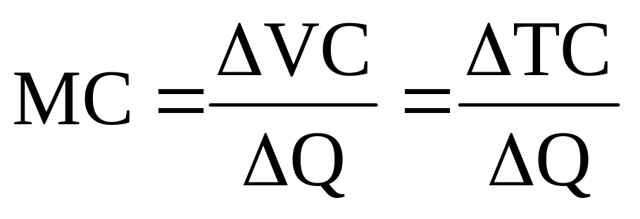
Costs in the Short Run (Unit Costs)
Marginal Cost (MC) is the cost of expanding output by one unit. Since fixed cost have no impact on marginal cost, it can be written as:
Notes:
14

Slide 61
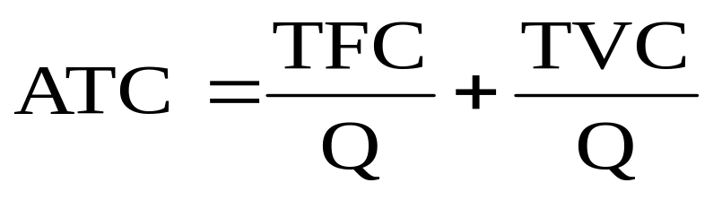
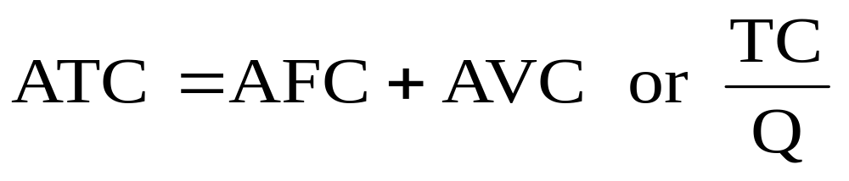
Costs in the Short Run (Unit Costs)
Average Total Cost (ATC) is the cost per unit of output, or average fixed cost (AFC) plus average variable cost (AVC). This can be written:
or
Notes:
15

Slide 62
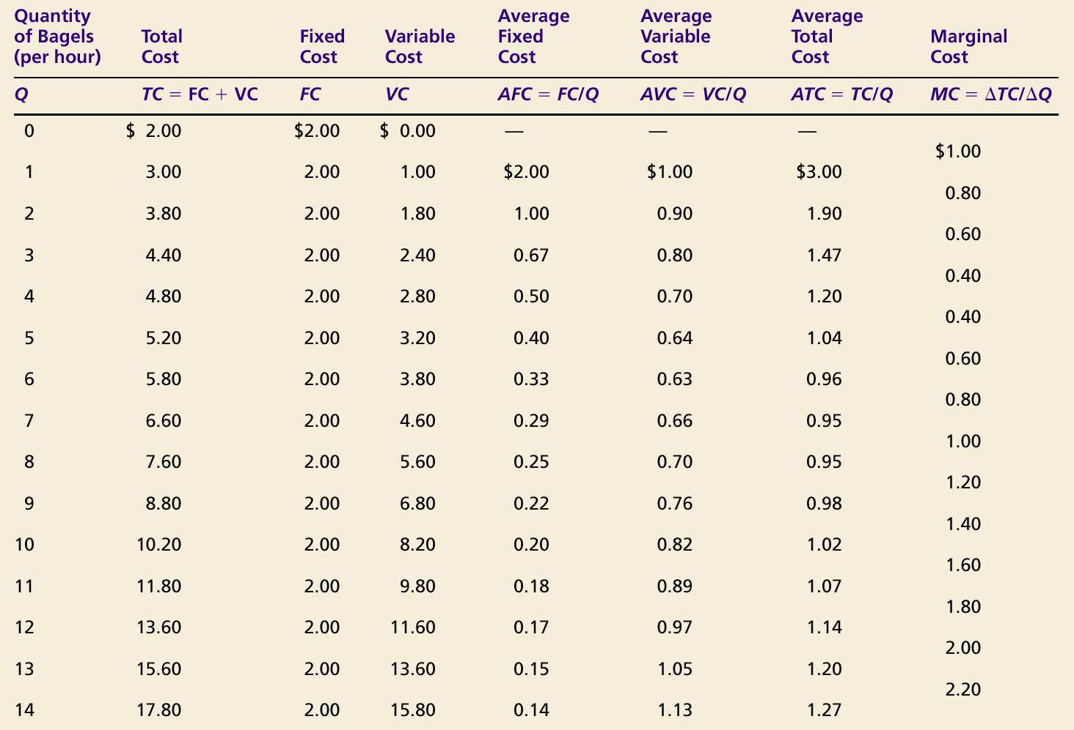

Slide 63
Total Cost, Total Variable Cost,
Total Fixed Cost Curves (SR)
Total
Cost
$18.00
TC
16.00
14.00
TVC
12.00
10.00
8.00
6.00
4.00
TFC
2.00
0
2
4
6
8
10
12
14
Quantity of Output (bagels per hour)
Copyright © 2004 South-Western

Slide 64
Marginal and Average Cost Curves (SR)
Costs
$3.00
2.50
MC
2.00
1.50
ATC
1.00
AVC
0.50
AFC
0
2
4
6
8
10
12
14
Quantity of Output (bagels per hour)
Copyright © 2004 South-Western

Slide 65
SR Cost Curves for a Firm
The line drawn from the origin to a point on the variable cost curve:
  Its slope equals AVC
  The slope of tangent at a point on TVC equals MC
  Therefore, MC = AVC at 7 units of output (point A)
Rs
TC
400
TVC
300
200
A
100
TFC
0
1
2
3
4
5
6
7
8
9
10
11
12
13
Output
Notes:
39

Slide 66
SR Cost Curves for a Firm
Unit Costs
  AFC falls continuously
  When MC < AVC or MC < ATC, AVC & ATC decrease
  When MC > AVC or MC > ATC, AVC & ATC increase
Cost
(Rs )
100
MC
75
50
ATC
AVC
25
AFC
0
1
2
3
4
5
6
7
8
9
10
11
Output (units/yr.)
Notes:
41

Slide 67
SR Cost Curves for a Firm
Unit Costs
  MC = AVC and ATC at minimum AVC and ATC
  Minimum AVC occurs at a lower output than minimum ATC due to FC
Cost
(Rs )
100
MC
75
50
ATC
AVC
25
AFC
0
1
2
3
4
5
6
7
8
9
10
11
Output (units/yr.)
Notes:
42

Slide 68
Cost in the Short Run
Relationship Between Production Function And Cost
  The relationship between the production function and cost can be exemplified by either increasing returns and cost or decreasing returns and cost.
Notes:
16

Slide 69
Cost in the Short Run
Relationship Between Production Function And Cost
  Increasing returns and cost
    With increasing returns, output is increasing fast relative to input and average variable cost and average total cost will fall relative to output.
  Decreasing returns and cost
    With decreasing returns, output is increasing slowly relative to input and av.variable cost and av. total cost will rise relative to output.
Notes:
17

Slide 70
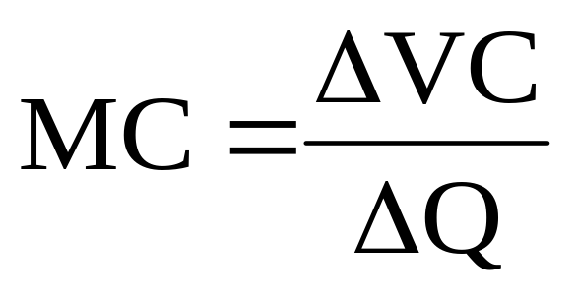

Cost in the Short Run
For Example: Assume the wage rate (w) is fixed relative to the number of workers hired. Then:
Notes:
18

Slide 71

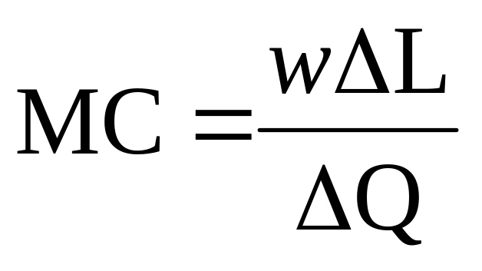
Cost in the Short Run
Continuing:
Notes:
19

Slide 72
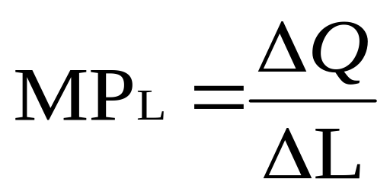
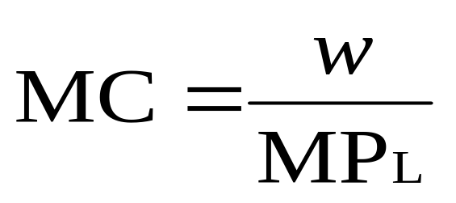
Cost in the Short Run
We know that :
In conclusion :
that is, a low marginal product (MP) leads to a high marginal cost (MC) and vice versa, given a wage rate w.
Notes:
21

Slide 73
Relationship Between SR Production Function And SR Cost
AP,
MP
AP
MP
Labour
MC,
AVC
MC
AVC
Output

Slide 74
Short Run Total Cost
Rs per time period
Total
Variable Cost
Decreasing
Increasing
returns
returns
Output per time period (units)

Slide 75
Short Run Total Product
Output per
time period (units)
Total product
Decreasing
returns
Increasing
returns
Input per time period (units)

Slide 76

Costs in the Long Run
The minimum cost combination can be written as:
  Minimum cost for a given output will occur when each rupee of input added to the production process will add an equivalent amount of output.
Notes:
57

Slide 77
Costs in the Long Run
Cost minimization with Varying Output Levels
  A firm’s expansion path shows the minimum cost combinations of labor and capital at each level of output.
Notes:
65

Slide 78
A Firm’s Expansion Path
Capital
per
year
The expansion path illustrates
the least-cost combinations of
labor and capital that can be
used to produce each level of
output in the long-run.
150
IC₃
IC₂
Expansion Path
100
C
75
B
50
IC₁
A
Q3 Isoquant
25
Q1
Q2
100
150
200
300
Labor per year
50
Notes:
72

Slide 79
A Firm’s Long-Run Total Cost Curve
Cost
per
Year
LR Total
Cost Curve
IC₃
C
IC₂
B
IC₁
A
Q1
Q2
Q3
Output, Units/yr

Slide 80
Long-Run Versus
Short-Run Cost Curves
What happens to average costs when both inputs are variable (long run) versus only having one input that is variable (short run)?
Notes:
73

Slide 81
Short-Run And Long Run Expansion Paths
Capital
per
year
Cost
C₃
The long-run expansion
path is drawn as before..
C₂
Long-Run
Expansion Path
C₁
K₂
Short-Run
Expansion Path
P
K₁
Q₂
Q₁
L₁
L₂
L₃
Labor per year
Notes:
77

Slide 82
A Firm’s LR And SR Total Cost Curves
Cost
per
Year
LR Total
Cost Curve
STC_{K=K2}
C₅
STC_{K=K1}
C₂
C
C₁
B
A
Q₁
Q₂
Output, Units/yr

Slide 83
Long-Run Cost Curves
LAC is got from calculating slope of a ray drawn on different points of LTC curve from the origin. LAC is U shaped.
Long-Run Average Cost (LAC)
  In the long-run:
    Firms experience increasing and decreasing returns to scale and therefore long-run average cost is “U” shaped.
Notes:
78

Slide 84
Long-Run Cost Curves
LMC is calculated as slope of a tangent drawn on different points of LTC curve. It is also U shaped.
LR Average Cost (LAC) & LR Marginal Cost (LMC)
  Long-run marginal cost leads long-run average cost:
    If LMC < LAC, LAC will fall
    If LMC > LAC, LAC will rise
    Therefore, LMC = LAC at the minimum of LAC
Notes:
82

Slide 85
Long-Run Average Cost and Long Run Marginal Cost
Cost
(Rs per unit
of output)
LMC
Economies of scale
LAC
A
Diseconomies of scale
Output
Notes:
85

Slide 86
Long-Run Cost Curves
Economies and Diseconomies of Scale
  Economies of Scale (Increasing Returns to Scale)
    Increase in output is greater than the increase in inputs.
    If input is doubled, output will more than double and average cost decreases at all levels of output.
  Constant Returns to Scale
    If input is doubled, output will double and average cost is constant at all levels of output.
  Diseconomies of Scale (Decreasing Returns to Scale)
    Increase in output is less than the increase in inputs.
    If input is doubled, the increase in output is less than twice as large and average cost increases with output.
Notes:
87

Slide 87
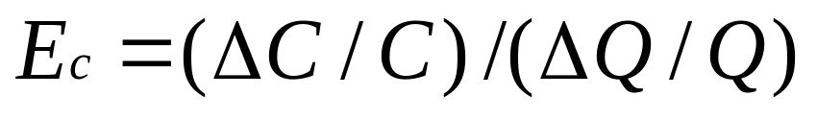
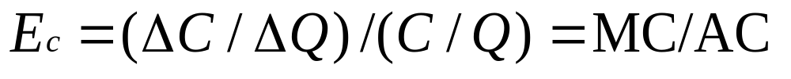
Long-Run Cost Curves
Measuring Economies of Scale
Notes:
89

Slide 88
Long-Run Cost Curves
Therefore, the following is true:
  E_{C} < 1: MC < AC
    Average cost indicates economies of scale
  E_{C} = 1: MC = AC
    Average cost indicates constant economies of scale
  E_{C} > 1: MC > AC
    Average cost indicates diseconomies of scale
Notes:
90

Slide 89
Long-Run Versus
Short-Run Cost Curves
The Relationship Between Short-Run and Long-Run Cost
  We will use short and long-run cost to determine the optimal plant size
Notes:
91

Slide 90
Average Total Cost in the Short and Long Run
Average
Total
ATC
in short
ATC
in short
ATC
in short
Cost
run with
run with
run with
small factory
medium factory
large factory
Rs12,000
ATC
in long run
0
1,200
Quantity of
Cars per Day

Slide 91
Average Total Cost in the Short and Long Run
Average
Total
ATC
in short
ATC
in short
ATC
in short
Cost
run with
run with
run with
small factory
medium factory
large factory
ATC
in long run
Rs12,000
10,000
Economies
Constant
of
returns to
scale
scale
Diseconomies
of
scale
0
1,000
1,200
Quantity of
Cars per Day

Slide 92
Long-Run Cost with Economies and Diseconomies of Scale
Cost
(Rs per unit
of output
SAC₁
SAC₃
LAC
SAC₂
A
Rs10
Rs8
B
SMC₁
SMC₃
If the output is Q₁ a manager
would chose the small plant
SAC₁ and SAC Rs8.
Point B is not on the LAC.
LMC
SMC₂
Q₁
Output
Notes:
102

Slide 93
Long-Run Average Cost
What is the firms’ long-run average cost curve?
  Firms can change scale to change output in the long-run.
  The long-run average cost curve is the envelope of the firm’s short-run average cost curves.
  The long-run average cost curve represents the minimum average cost for any level of output.
Notes:
103

Slide 94
Long-Run Cost
Observations
  The LAC does not include the minimum points of small and large size plants.
  LMC is not the envelope of the short-run marginal cost.
Notes:
104

Slide 95
Production With Two
Outputs--Economies Of Scope
Economies of scope exist when the joint output of both products by a single firm is greater than the output that could be achieved by two different firms each producing a single output.
What are the advantages of joint production?
  Consider an automobile company producing LCVs and HCVs (Tata Motors, Ashok Leyland)
  Indigo, Air India - passenger airlines plus freight cargo.
  LG, Samsung, Videocon – TVs, WMs, Micowaves, refrigerators.
Notes:
106

Slide 96
Production With Two
Outputs--Economies Of Scope
Advantages
1) Both share management resources.
2) Both use the same labor skills and type of
machinery.
3) Sharing of distribution and logistic channels
4) Sharing of R&D expenditure.
Notes:
107

Slide 97
Production With Two
Outputs--Economies Of Scope
Observations
  There is no direct relationship between economies of scope and economies of scale.
    May experience economies of scope and diseconomies of scale
    May have economies of scale and not have economies of scope
Notes:
113

Slide 98
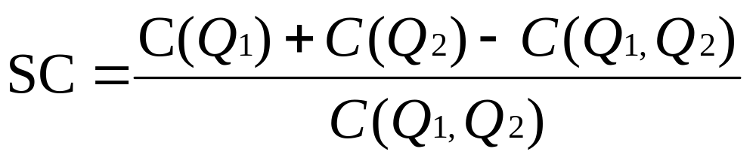
Production With Two
Outputs--Economies Of Scope
The degree of economies of scope measures the savings in cost and can be written:
  C(Q₁) is the cost of producing Q₁
  C(Q₂) is the cost of producing Q₂
  C(Q₁Q₂) is the joint cost of producing both products
Notes:
114

Slide 99
Production With Two
Outputs--Economies Of Scope
Interpretation:
  If SC > 0 -- Economies of scope
  If SC < 0 -- Diseconomies of scope
Notes:
115

Slide 100
Example
Given that MP_{L} = 40 units of output and MP_{K} = 120 units. Also given that w =Rs.20 and r = Rs.30.
a) Why is this firm not maximising Q or minimising costs?
b) How can the firm maximise Q or minimise costs?

Slide 101
Example
A fast‑food restaurant currently pays $5 per hour for servers and $50 per hour for rental machinery. The restaurant uses seven hours of server time per unit of machinery time. Determine whether the restaurant is minimizing its cost of production when the ratio of marginal products (capital to labor) is 12. If not, what adjustments are called for to improve the efficiency in resource use?

Slide 102
Example
Estimates of the industry long‑run average cost of producing a type of plastic hook were made in 1970 and again in 1985. Estimates of these relationships are presented as:
LAC ₇₀ = 10 ‑ 0.3Q + 0.05Q ²
LAC ₈₅ = 8 ‑ 0.6Q + 0.04Q ²,
where Q is output in hundreds of cases per day, and LAC is average cost in dollars per unit. Assume that costs are expressed in inflation adjusted or constant dollars.
From the information available, can you learn anything about economies of scope and economies of scale in this industry? Explain. Do these curves reveal anything about the state of technology in this industry? Explain.

Slide 103
Example
The cost of producing 600 small fiberglass sailboats per year, and the cost of producing sails and fittings necessary to make the boats seaworthy in a single plant, are together $780,000. If produced in separate plants, the boats would cost $540,000, and the sails and fittings would cost $180,000.
From this information, what can be learned about (1) economies of scale and (2) economies of scope in the production of sailboats, sails, and fittings? Perform any necessary calculations and explain.

Slide 104
Example
Higher highway speed reduces driving time but increases petrol consumption by reducing petrol mileage. The tradeoff between petrol consumption and travelling time for a trip of 360 kms can be represented by an isoquant. The following information is given -
At 50 kms per hour, the distance of 360 kms can be covered with 10 litres of petrol (point A). At 60 kms per hour, the 360 kms can be covered with 12 litres of petrol ( point B ). At 72 kms per hour the same trip will require 15 litres of petrol (point C).
Show the tradeoff between driving time and petrol consumption with the help of an isoquant.
What is the MRTS of petrol for driving time between points A & B; and between points B & C? What does MRTS show?
What additional information is required to find out the optimal combination of travel time and petrol consumption? Explain clearly.

